Slide 1
Identity and Access Management
Architect, Azure GSI Center of Excellence, foo@microsoft.com
Notes:
Azure Active Directory is our cloud based directory and identity management service.
It is not Windows Server Active Directory running in a virtual machine. It is a multi-tenant identity and management service designed from the ground up to support modern cloud-based applications.

Slide 2




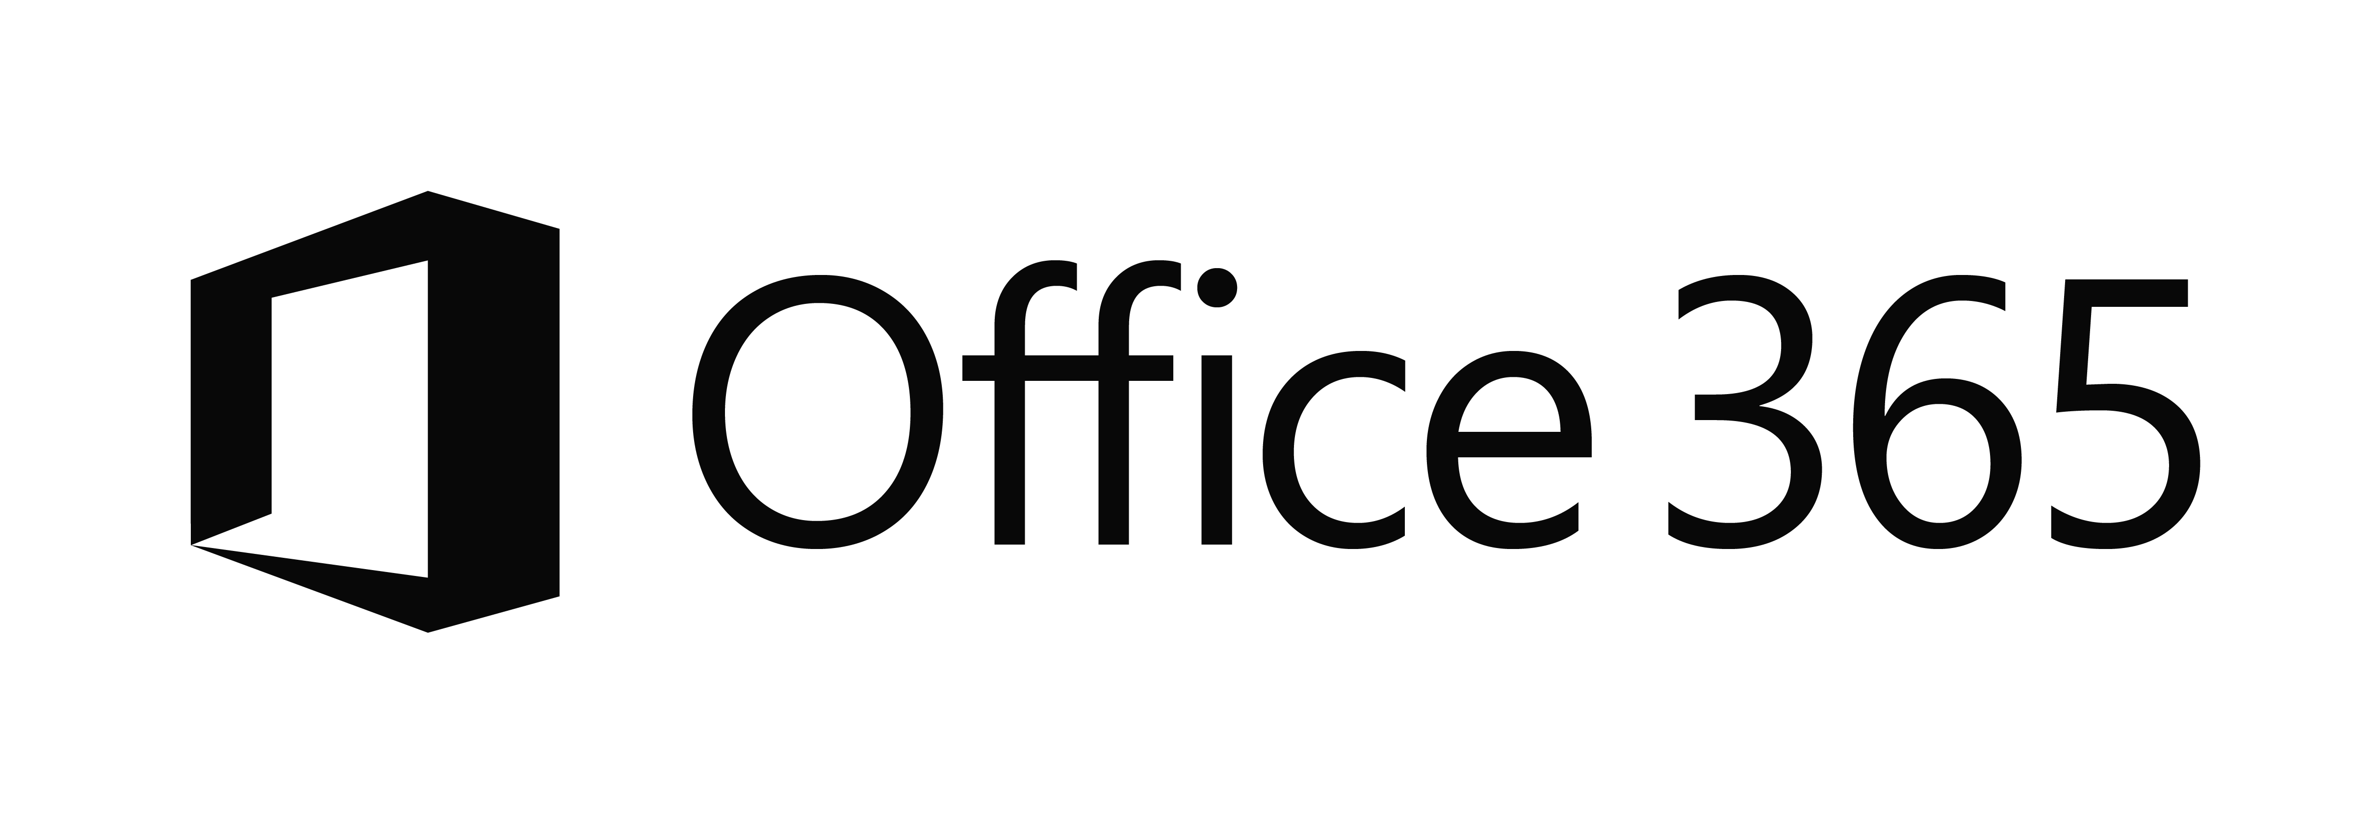









EC2
On-Premises
Managed devices
Private Cloud
Notes:
The enterprise identity landscape is complicated. In fact, it can quickly become chaotic as represented here.
Enterprises rely on an increasing number of SaaS applications to run their business. Each one of these applications potentially introduces additional credentials user’s must manage and keep up with. Which in turn results in bad behaviors such as using the same username and password for different accounts. Or, writing passwords on post-it notes.
Gone are the days where users only signed in at their desk on a desktop computer in their office. The enterprise worker today is mobile. Laptops, mobile phones, and tablets are common expectations for today’s worker. And while IT strives to empower workers on these devices, such empowerment must be met with ways for the enterprise to manage these devices and maintain strong security.
Where is user identity managed? Unless you are a new startup where all your identities are in the cloud, chances are you have an on-premises directory such as Windows Server Active Directory or 3rd party identity provider solutions.
How can you leverage your existing on-premises directory to enable users to sign-on to these SaaS applications running in the cloud?
How can you make your existing on-premises line-of-business applications available to users from their mobile devices when they are not in the office?
How can you architect new solutions to create new business opportunities?
And how will you do all this securely?
In a way that yields a positive experience for end-users?

Slide 3
Agenda
Application Management and Access
Hybrid Identity
Developing applications for Azure Active Directory

Slide 4










Identity as the foundation
Simple connection
Self-service
Single sign on
On-Premises
Username
3rd Party & Custom Line-of-Business Apps
•••••••••••
LDAP Directories
Salesforce
Concur
Dropbox
…..
Custom Apps
Windows Server Active Directory
Microsoft Azure Active Directory
Notes:
What is common for many organizations today is the presence of not just an on-premises environment, but also a cloud environment.
On-premises, there are typically active directories and LOB applications the business depends on, as well as domain-joined computers and devices.
In the cloud we have a growing number of SaaS applications such as Office 365, 3rd party apps, and your own custom cloud apps.
<Click>
In between we have Azure Active Directory. This provides an identity foundation for modern cloud application scenarios. This includes services, API’s, and protocol support for you to build secure solutions in the cloud. But Azure AD also provides tools and services to allow applications running on-premises available from the cloud. For example, applications that previously were deployed on client desktop machines with Windows Integrated Auth running on-premises today can be accessed from the cloud (Azure Remote App). Or, an intranet site running on-premises today can be accessed from the cloud (Azure Application Proxy). All without having to modify the existing applications.
<Click>
Azure AD builds on this foundation identity services. The most obvious being single-sign-on services. So, whether you authenticate in the cloud or on-premises, your identity (and credentials) are the same. Azure AD also provides self-service identity management services, empowering user to manage and service some of their own identity needs (password resets for example). And finally, Azure AD provides a path to connect your on-premises and cloud environments through a simple set of tools that you can run and configure to meet the needs of your environment.

Slide 5
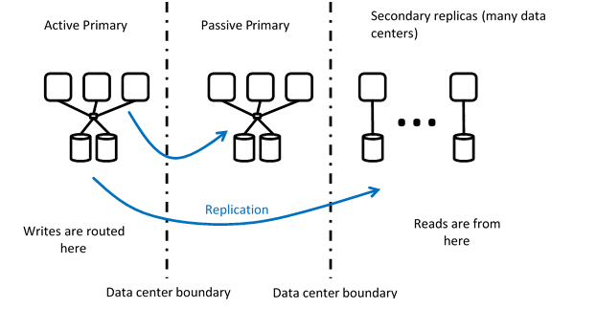
Azure Active Directory
Global replicated service
Free, Basic, Premium

Slide 6
Application Management & Access

Slide 7
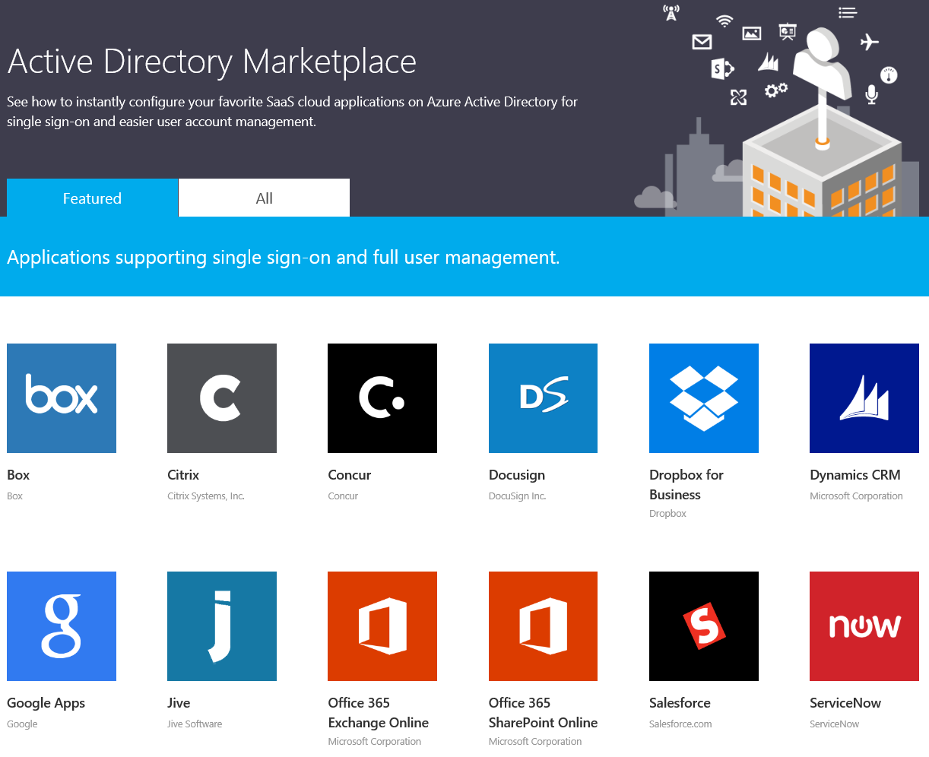
Application Management
Provision applications for the organization.
Automatic provisioning of user accounts.
SSO experiences for end-users.
Full control of application access policies.
http://azure.microsoft.com/en-us/marketplace/active-directory
Notes:
The application management capabilities in Azure Active Directory enable you to easily bring into your directory popular third-party SaaS applications.
We’re approaching 3 thousand SaaS applications today that Azure AD has direct federation capabilities with.
Point-and-click onboarding and configuration.
After an application is added to your Azure Active Directory, you will be able to take advantage of things like automatic provisioning of user accounts.
As users are added to Azure AD an account is automatically provisioned in the SaaS application for that user.
By integrating these applications into your Azure Active Directory, you are able to deliver positive end-user experiences such as SSO. Users who are already authenticated will be able to access the applications they need without having to re-enter credentials.
Finally, the application management capabilities in Azure AD puts IT in control of managing the access to applications. For example, if you have a SaaS application that the finance group uses, then you can assign group access to just the finance group. Or, if you need to control access at an individual level, you can do that as well.
The point is that you have a lot of flexibility in the how applications are added to your directory and full control over the applications that users access.
As a side note, while this slide talks specifically to SaaS applications in the Marketplace, you’re not limited to just these. The applications can also be your own custom-built applications.
Reference
http://azure.microsoft.com/en-us/marketplace/active-directory/

Slide 8
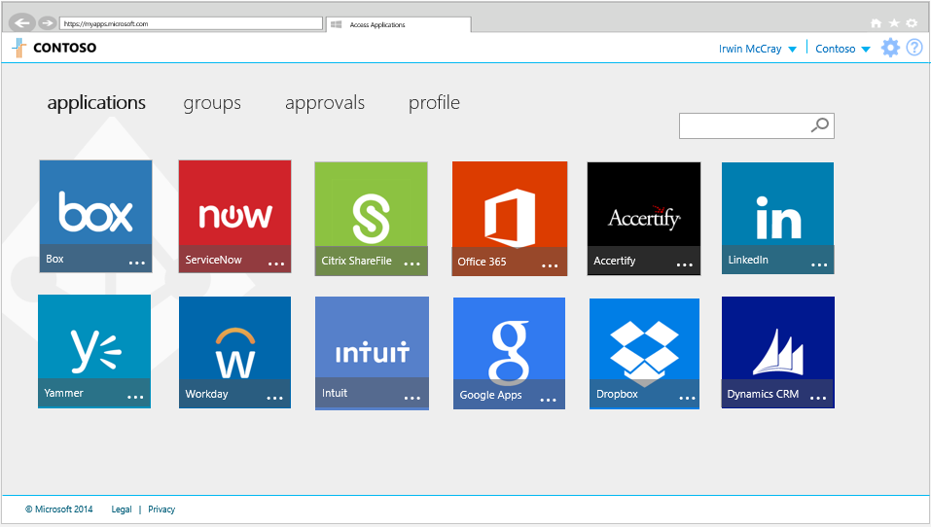



Application Access
Access Panel is where users see and launch apps from.
Reachable from the web
https://myapps.microsoft.com
Reachable using native devices running Android and iOS.
Notes:
The access panel is where end-users can see and launch the applications they have been given access to.
Users can reach the access panel using their browser. Microsoft also provides native client applications for devices running Android and iOS.
The access panel is also where users can manage their profile, group membership, and change passwords.

Slide 9
Application Management and Access
Notes:
1_Demo_App_Integration.docx

Slide 10
Hybrid Identity
Notes:
Most organizations have some form of identity directory on-premises today. Therefore, there is a need to bridge the gap between on-premises and the cloud. Or, extend your on-premises directory to the cloud.

Slide 11

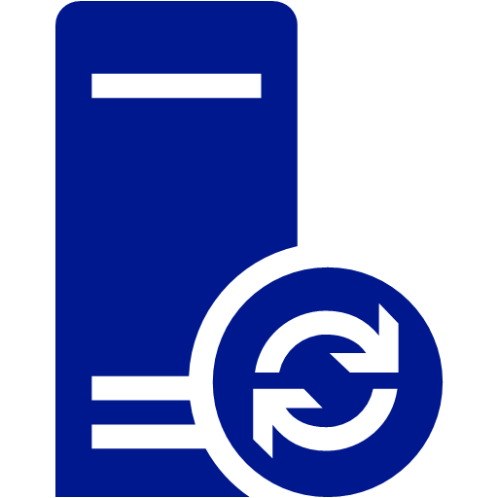
Azure AD Connect – Your Identity Bridge
On-Premises
Generic Identity Stores
Azure AD Connect
(sync + sign on)
Salesforce
Concur
Dropbox
…..
LDAP Directories
Azure AD
Windows Server Active Directory
Notes:
That’s what Azure AD Connect does. Azure AD Connect is a tool that you can use to extend on premises environments to Azure AD.
It works with Windows Server AD, LDAP directories, and other identity solutions. It’s essentially a Windows service that runs in the background syncing user identities to Azure AD.
It is part of your on-premises environment, typically running on a dedicated server joined to the domain.
When users are added, removed, or modified on-premises, Azure AD Connect synchronizes those changes in the directory to Azure AD.
As users access cloud applications registered in your Azure Active Directory, they are able to authenticate to Azure AD using the same set of credentials they use on-premises.
AAD Connect consolidates deployment of identity bridge components. It includes DirSync, Azure AD Sync, and the FIM connector all as part of the sync services. It also includes the ability to configure ADFS, and adds the Health components to help monitor the health of your identity infrastructure.
Reference
There will be parity between MIM and AAD Connect when it comes to supported directories.
https://technet.microsoft.com/en-us/library/dn510997(v=ws.10).aspx

Slide 12
Steps to “Bridge” your identity
Configure Azure AD for Directory Integration
Configure Azure AD Connect
Verify configuration
Notes:
When planning the identity integration you will perform the following steps.
The first step is to configure the Azure AD to support directory integration with a local directory. This can be done either via the portal or by using the Set-MsolDirSyncEnabled PowerShell cmdlet
The next step is to configure the Azure AD Connect appliance on an On-Premises server. This server will be responsible for synchronizing the On-Premises Active Directory with Azure AD.
The final step is to verify the configuration and perform the initial sync.

Slide 13
Configure Azure AD for Directory Integration
Notes:
2A_Demo_Enable_Directory_Integration.docx

Slide 14
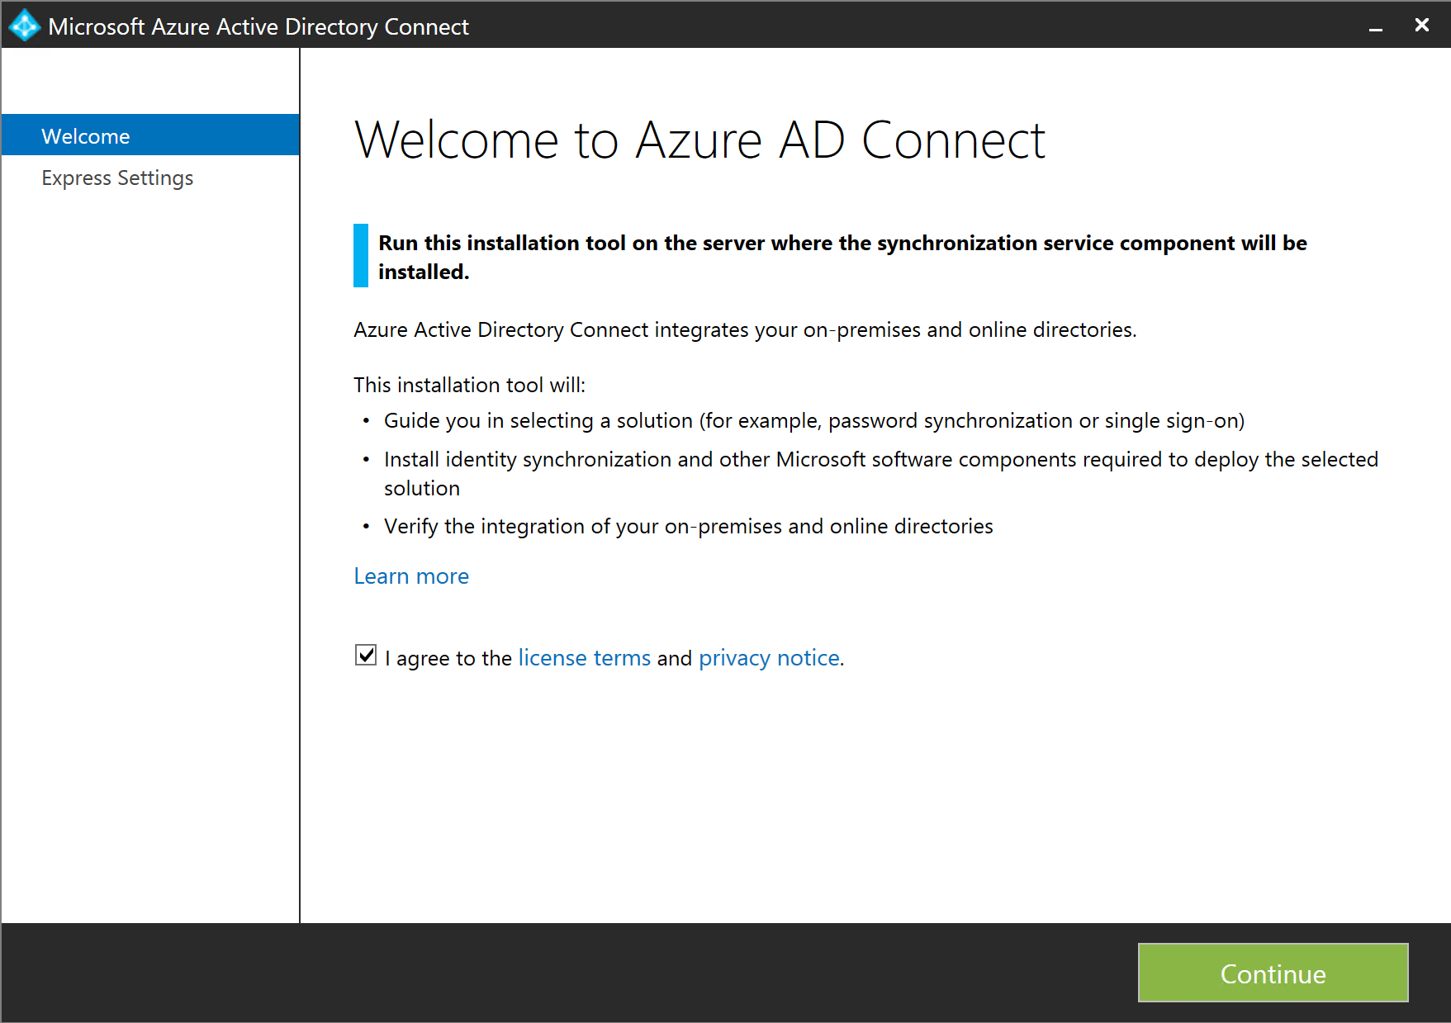
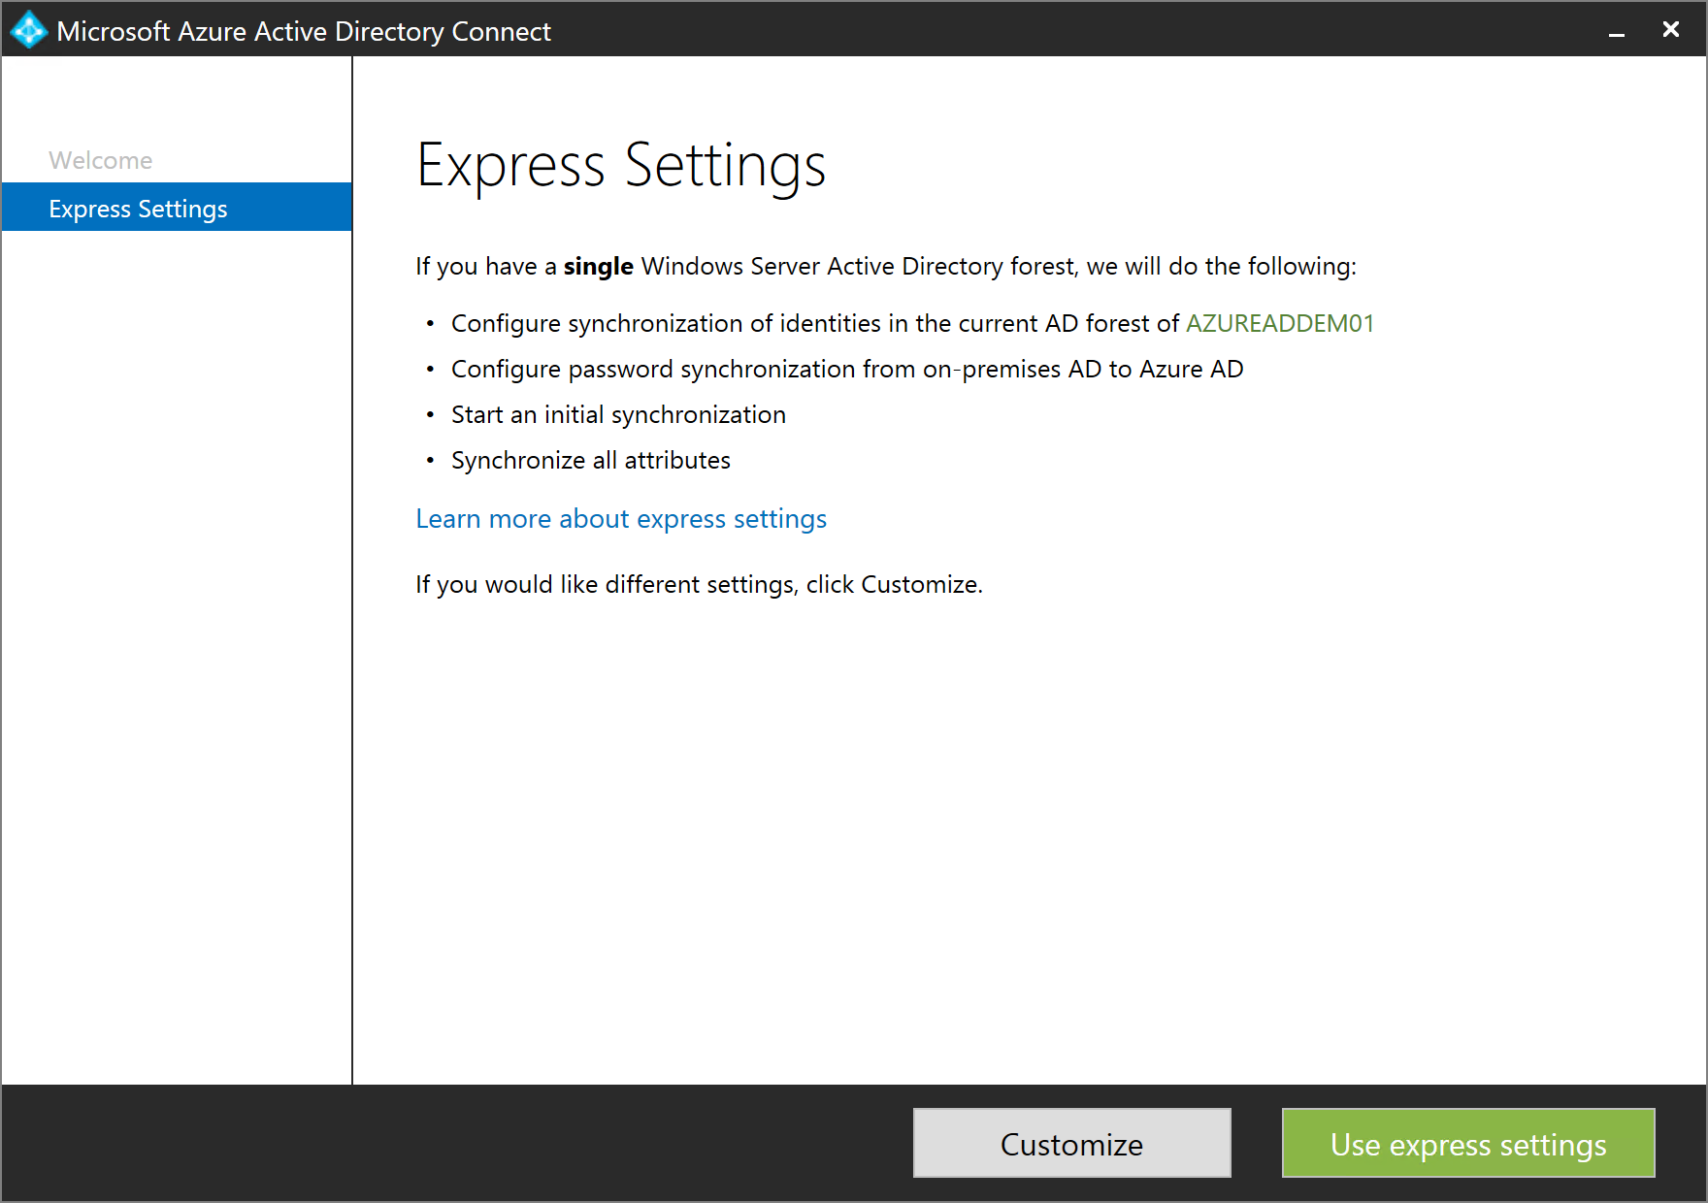
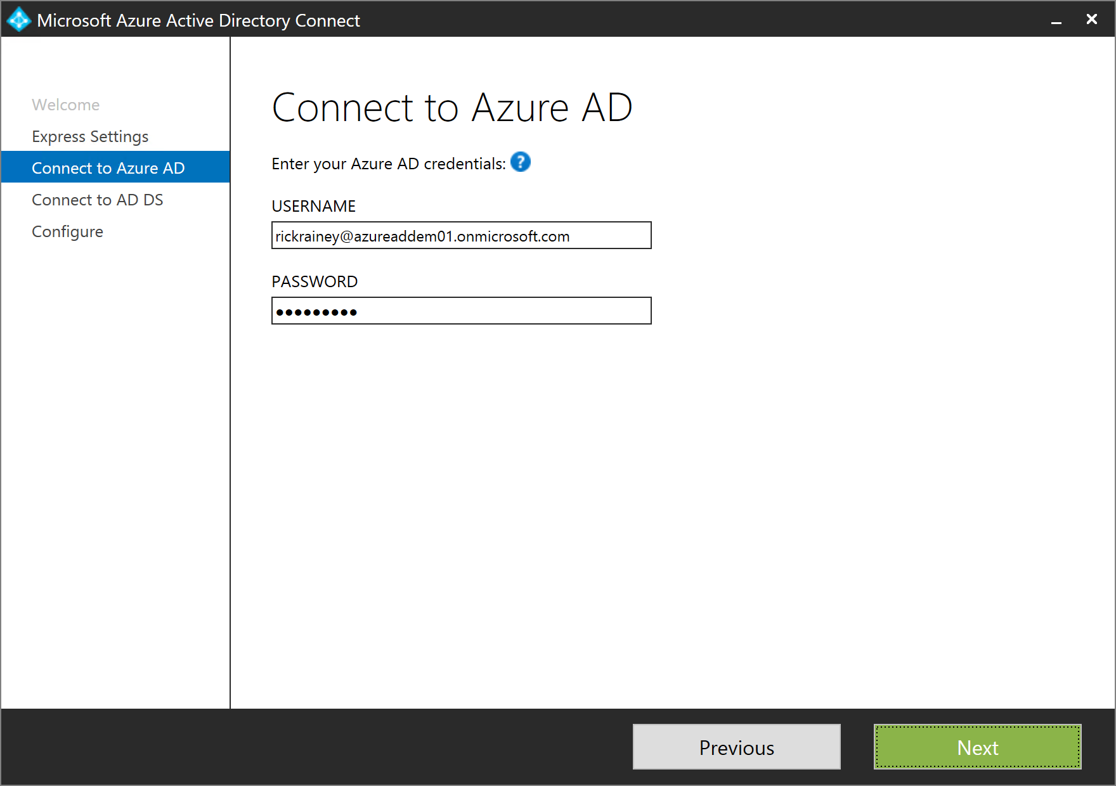
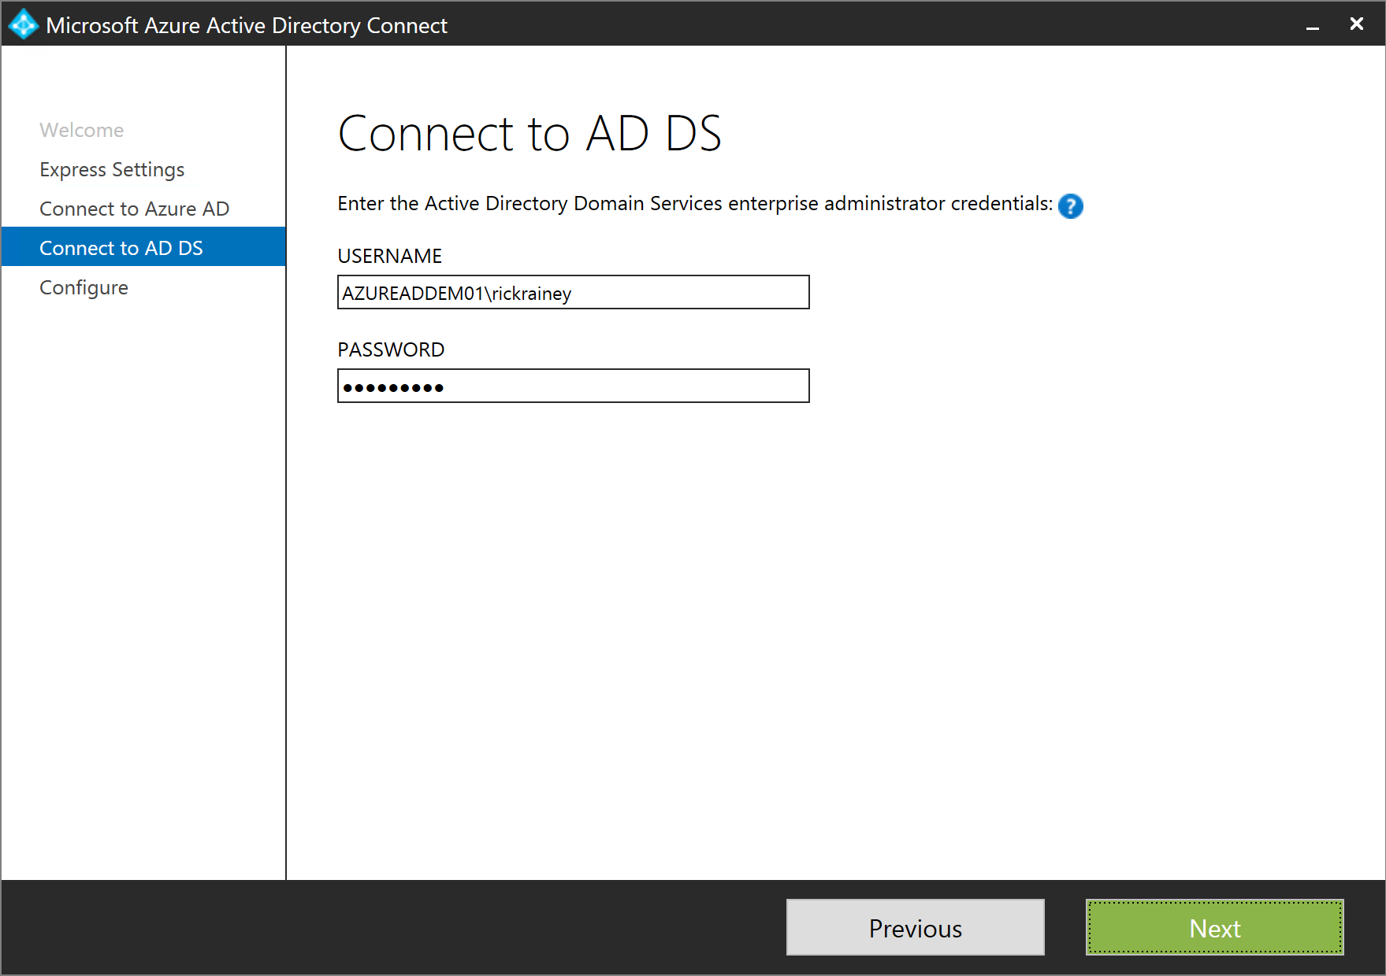
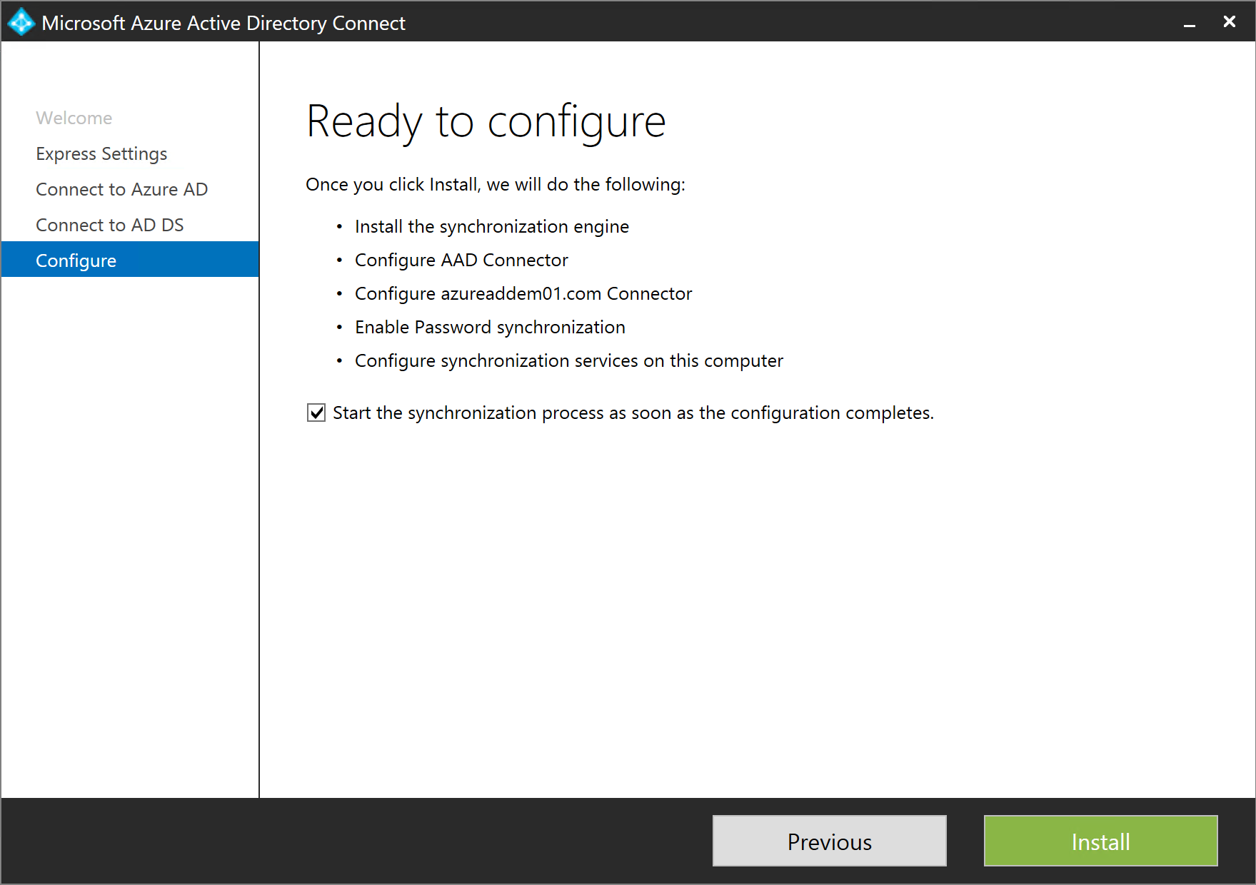
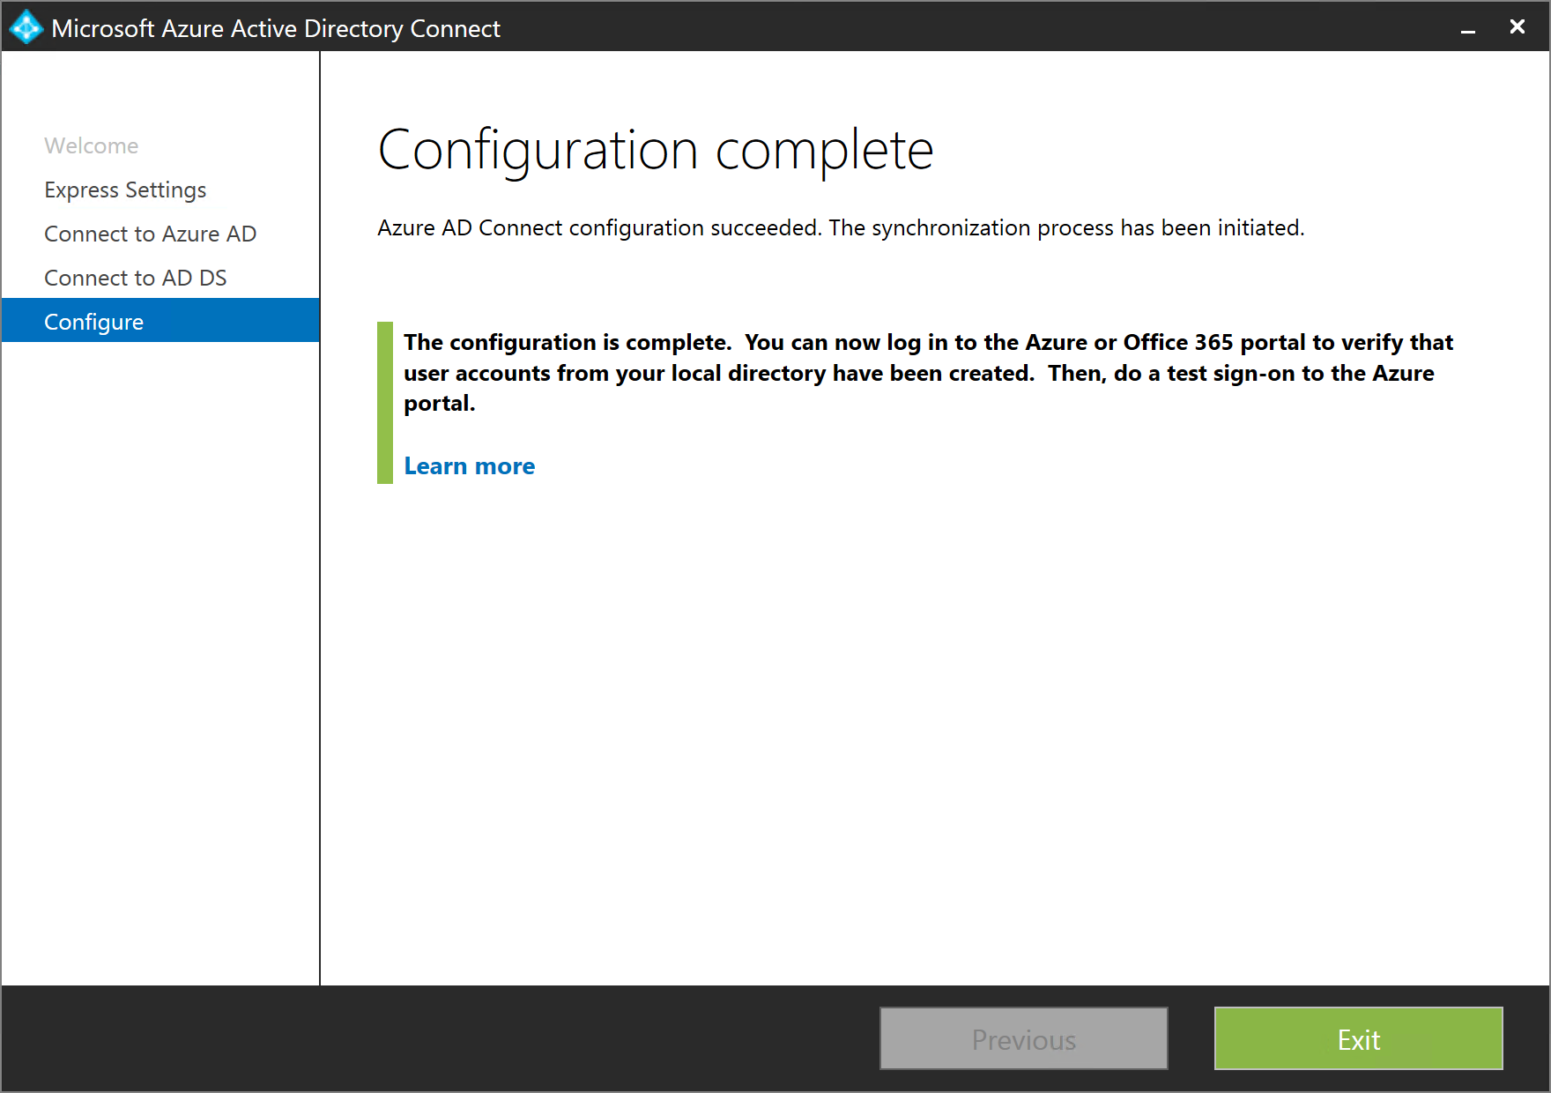
Azure AD Connect – Express Settings
Notes:
Continuing from the demo, you have download the MSI for Azure AD Connect onto the machine that will be your sync server. This is a machine that is joined to your on-premises domain. You have run the MSI and this is the screen you get.
<Click>
You have two options for configuring Azure AD Connect. You can choose either Express Settings or a Customized configuration. For this first look we will explore the Express Settings path.
Notice the 2nd bullet that says password synchronization will be configured. We will cover that shortly.
<Click>
The Express Settings path asks you to provide two sets of credentials. The first are credentials for the Global Administrator in the Azure AD Tenant. The reason Azure AD Connect asks for this credential is so that it can create the service account that will be used by the synchronization service. The synchronization service will be configured to use this service account when synchronizing objects between Azure AD and the on-premises directory.
<Click>
The next set of credentials you must provide are those of an enterprise administrator. It is used as the AD Connector account that performs read/writes in the local directory during synchronization.
<Click>
This next page is simply summarizing what is about to happen. When you’re ready, press install. In about 5 minutes (or less), you will see this page indicating Azure AD Connect is configured and the synchronization service is running.
Reference
https://technet.microsoft.com/en-us/library/dn776280.aspx

Slide 15
Verify directory synchronization
Notes:
2B_Demo_Verify_Directory_Synchronization.docx

Slide 16
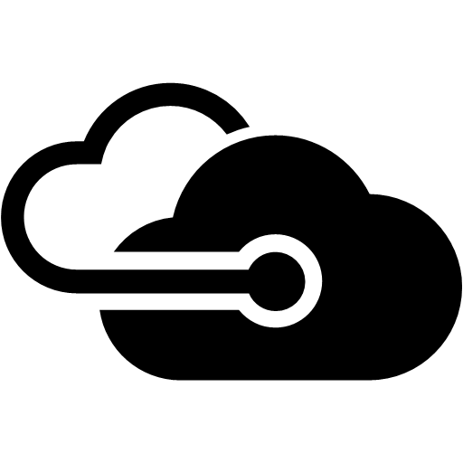
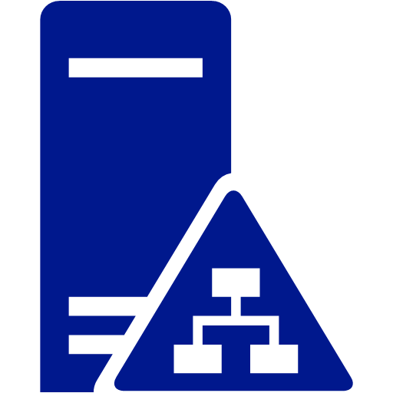


Password Sync sign-on method
On-Premises
johndoe@xyz.com
P@ssw0rd!
johndoe@xyz.com
##(!@JS#^
Azure AD Connect
(sync + sign on)
Cloud Apps
Office 365
SalesForce
DropBox
Custom Apps
Active Directory
Azure AD
Synchronization
Hash of user’s password is synced to Azure AD.
Authentication
User authenticates to Azure AD to access Cloud Apps.
John Doe
Notes:
Password Sync is a feature of the Azure Active Directory Sync tool that synchronizes the hash of the user passwords from your on-premises Active Directory to Azure Active Directory (“Azure AD”).
This feature enables your users to log into their Azure Active Directory services (such as Office 365, Microsoft Intune, CRM Online, etc.) using the same password as they use to log into your on-premises network.
It is important to note that this feature does not provide a true Single Sign-On (SSO), this method is often called Same Sign on to distinguish it from Single Sign-On.

Slide 17
Azure AD Connect - Custom Settings
Configure Active Directory Federation Services (AD FS)
Synchronize multiple on-premises directories and forests
Filter synchronization by group for pilot deployments
Select attribute used to identify users
Restrict attributes synchronized for specific apps.
Write-back capabilities to on-premises directories

Slide 18
Azure AD Connect: Sign-on Methods
Password Synchronization
A hash of the user’s On-Premises password is stored in Azure AD
Azure AD handles authentication for cloud apps
Active Directory Federation Services (AD FS) / SSO
User’s password is never synchronized to Azure AD
Cloud app authentication using federation trust between Azure AD & AD FS
Password Synchronization can be used as a backup *
Notes:
Azure AD provides the following authentication methods for end users to authenticate.
When using Password sync the user will authenticate using the same username and the same password as they do On-Premises. This way of authenticating is often referred to as Same Sign On to distinguish it from Single Sign On.
In a True Single Sign On scenario using AD FS the authentication is performed against the On-Premises directory. In this scenario the users passwords are never synchronized to Azure AD.
When you setup federation you will establish a trust between your Azure AD and your AD FS environment.
In an federated scenario all authentication is done using the AD FS infrastructure. The AD FS environment must be designed to be fault tolerant as without it no one will be able to authenticate.
A typical production setup of AD FS will have AD FS proxies that will handle the authentication for users accessing it from the internet. The AD FS proxies will typically have forms based authentication. The proxies will talk to the AD FS Servers which then will authenticate the users against the On-Premises Active Directory.
On-Premises users will authenticate against directly against the AD FS servers which usually are configured for Windows Authentication. Because of this authentication mechanism the users will not be prompted for any credentials.
In case of AD FS outages you can fall back to using Password Synchronization

Slide 19
Scenarios for AD FS / SSO sign-on
AD FS is already configured On-Premises
Security policy prohibits storing passwords in the cloud
Desktop SSO from a domain-joined machine is required.
Capabilities that are specific to AD FS are required
On-premises multi-factor authentication or smart-card support for SSO
Conditional access for both on-premises and cloud resources
Notes:
There are a number of scenarios that are only available using federation.
If the customer already has deployed AD FS On-Premises it is very likely that they will want to use it for authentication scenarios instead of creating a new environment.
There may also be security policies implemented at the customer which will prohibit storing passwords in the cloud.
As we discussed on the previsous slide having a AD FS environment configured correctly will allow seamless single sign on from domain joined machines.
AD FS also allows for additional secarions like On-Premises multi factor authentication and/or smart card support. It will also provide for more fine grained access scenarios

Slide 20
AD FS sign-on method
On-Premises
johndoe@xyz.com
P@ssw0rd!
Azure AD Connect
(sync + sign on)
Cloud Apps
Office 365
SalesForce
DropBox
Custom Apps
Active Directory
Azure AD
Synchronization
Directory objects but not passwords or hashes of passwords are synchronized to Azure AD
Authentication
User authenticate via Azure AD to access Cloud Apps.
Azure AD will use AD FS On-Premises to authenticate users.
John Doe
Notes:
AD FS requires that the user objects are synchronized to Azure AD.
When the user tries to logon using their UPN Azure will perform a home realm discovery to identify how to authenticate the user. If the user’s UPN’s domain is federated the authentication request will be transferred to the registered ADFS endpoint and the authentication will be performed against the On-Premises directory

Slide 21
Azure AD Connect – Custom Settings
Notes:
2C_Demo_AAD_Connect_Custom_Settings.docx

Slide 22
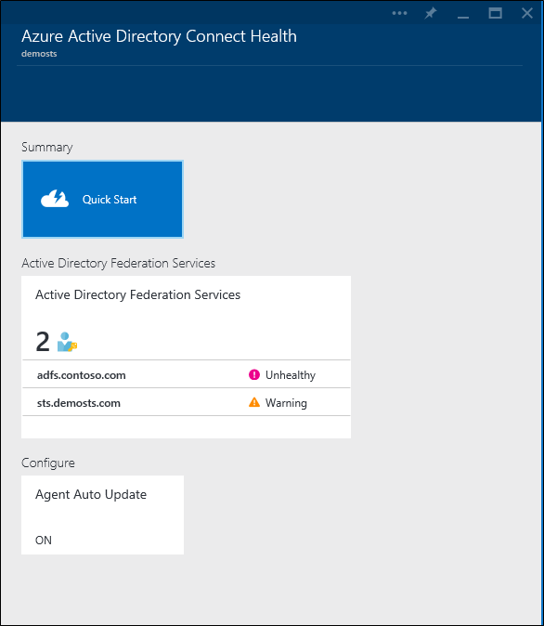
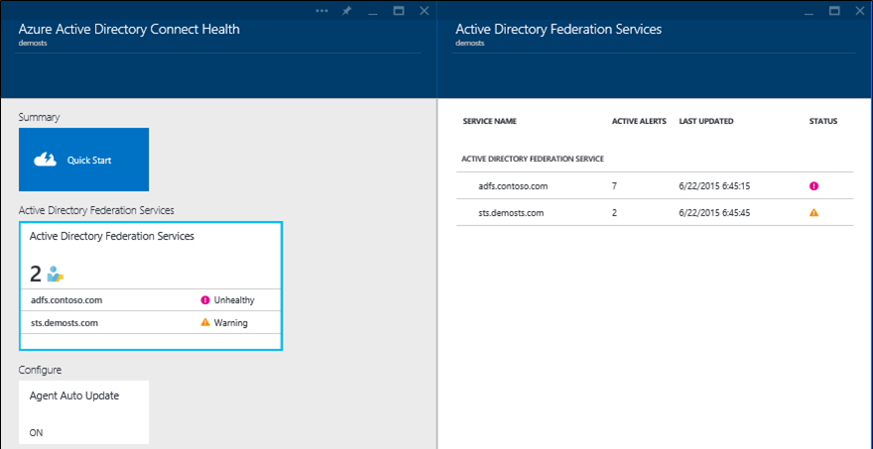
Azure AD Connect Health
Monitor ADFS service (cloud or On-Premises) for reliable & highly available authentication.
Requires installation of agent
Analyze ADFS logins for usage & capacity planning based on app, authentication, location & failures.
Email notification for critical alerts.
Perform forensic analysis on top users with bad passwords.
Available in Azure AD Premium
Notes:
Azure AD Connect Health is a cloud based service that can monitor and secure cloud and On-Premises identity infrastructure. It will provides customers who use ADFS with detailed monitoring, reporting and alerts for their ADFS servers.
The information is surfaced in the Azure AD Connect Health portal. Using the Azure AD Connect Health portal you can view alerts, performance monitoring, and usage analytics.
You can configure Azure AD Connect Health to send email notifications for critical alerts
Requires Azure AD Premium
Search for “health” in the market place to add this to your portal blades.
If you want to monitor On-Premises ADFS infrastructures you need to install the Azure AD Connect Health Agent on the On-Premises servers

Slide 23
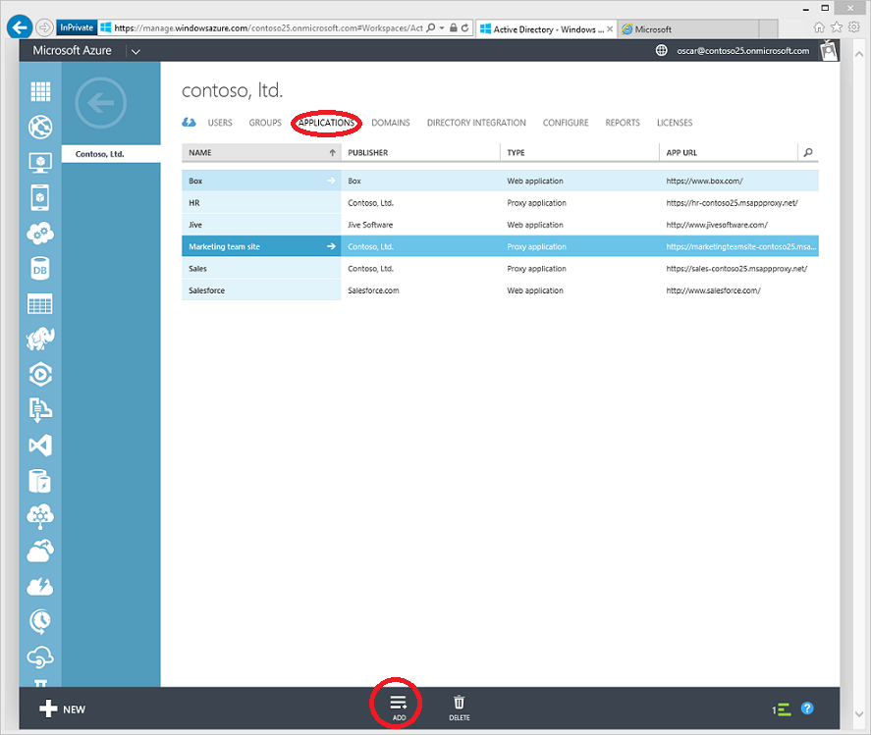
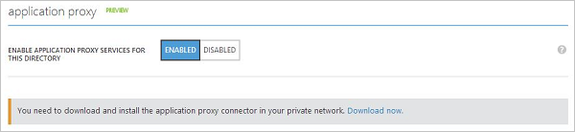
Azure AD Application Proxy
Application Proxy provides single sign-on (SSO) and secure remote access for web applications hosted on-premises
Requires installation of agent
Single sign-on
Azure AD Application Proxy provides single sign-on to applications that use Integrated Windows Authentication (IWA), or claims-aware applications
Leverages the Service Bus technology
Available in Azure AD Basic, Premium

Slide 24
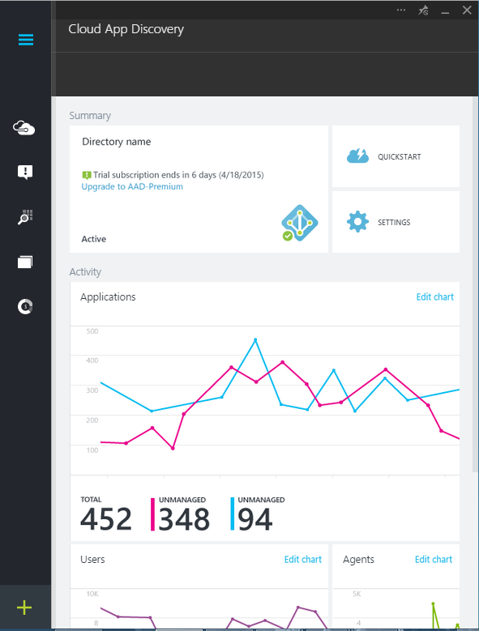
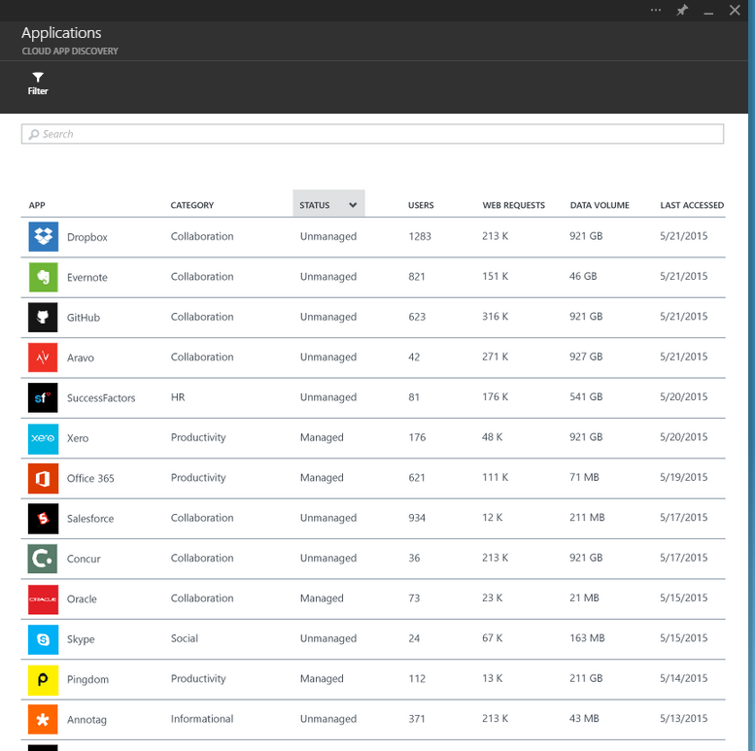
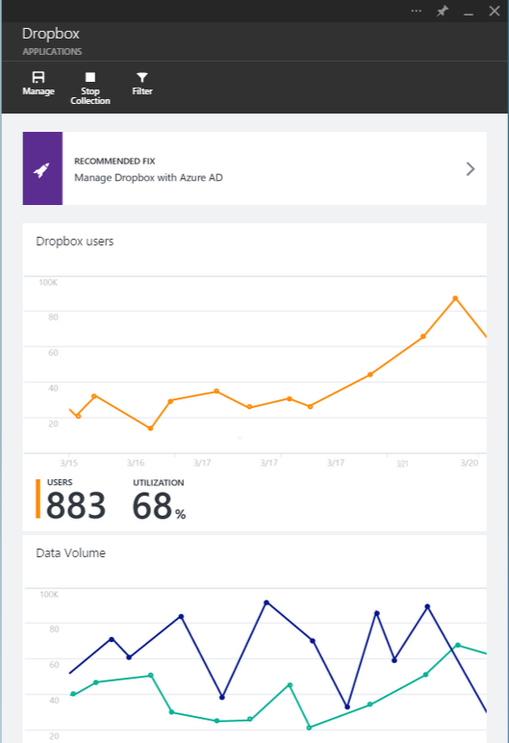
Cloud App Discovery
Discover cloud apps in use in the organization
Measure app usage
Identify which users are using an app.
Enables you to Easily integrate with AAD to bring applications under management
Requires an agent on the user’s computers
Available in Azure AD Premium
Notes:
With Cloud App Discovery, you can:
Discover applications in use and measure usage by number of users, volume of traffic or number of web requests to the application.
Identify the users that are using an application
Export data for addition offline analysis. This will help in prioritizing which applications to bring under IT control and integrate them easily to enable Single Sign-on and user management.
With cloud app discovery, the data retrieval part is accomplished by agents that run on computers in your environments. The app usage information that is captured by the agents is send over a secure, encrypted channel to the cloud app discovery service. The cloud app discovery service evaluates the data and generates reports you can use to analyze your environment.
Requires Azure AD Pemium
To Configure:
Go to https://appdiscovery.azure.com.
Sign-in using Work/School account.
Download the cloud app discovery agent.
Install the agent on the machines you want to monitor.

Slide 25
Developing applications for Azure AD

Slide 26
The “steps” to develop apps for Azure AD
Register your application with Azure AD
Configure your application to externalize authentication to Azure AD
Notes:
Azure AD will not just blindly issue tokens for users who can successfully authenticate. When a user authenticates, it must tell Azure AD which application (or resource) the user is requesting. If the user successfully authenticates, then Azure AD will issue a token that is valid for that application (not any application). Therefore, the first step is to register your application with Azure AD.
Next, you need to configure your application to externalize authentication of users to Azure AD. In other words, you are trusting Azure AD to properly authenticate users and issue a token for your application when a user authenticates. Anyone can show up at your application’s front door and present a token to you. So, you should have code to validate the token before you allow the user to access your application.

Slide 27
Register an application with Azure AD
Use the non-preview Azure Management Portal
Automate it using PowerShell
Use Visual Studio
Notes:
To register an application with Azure AD, there are a few approaches you can take. The first (and easiest) is to use the Azure Management Portal and click through a few dialogs. As you respond to a couple of simple questions in the dialogs, Azure AD will generate information needed for you to authenticate users with from your applications.
You can also automate it using PowerShell or REST API’s. If you’re registering applications for multiple customer environments, then spending the time to automate the process is generally recommended.
For developers working in Visual Studio, you can let Visual Studio do the application registration for the application your are developing.

Slide 28
Configure your app to use Azure AD
Authority URL
Who your app trusts to authenticate users
App Id
Generated by Azure AD during app registration
Signing Keys
Generated for each Azure AD tenant
Used to validate tokens issued by Azure AD
Notes:
To externalize the task of authenticating users to Azure AD, your application needs to be configured with a few key pieces of information. For example, the application needs to know the URL of the authority (IdP) that your app trusts to authenticate users and issue security tokens.
Your app also will need to know the Application ID that Azure AD generated for your application when registering the application in Azure AD.
Finally, your application needs to know the signing keys for Azure AD. This is used by the OWIN middleware to “process” the tokens. This means validating the token is from the IdP your app trusts.

Slide 29

Developing Web Apps for Azure AD using OpenID Connect / OAuth 2.0
Unauthenticated user accesses app
User is redirected to the Authorization Endpoint
User Authenticates
User consents to allow app to sign-in as user and read users profile
Azure AD issues a token that the user presents to the app
The OWIN middleware processes the token and issues a session cookie if the token is valid
Authentication cookie is set and user is returned to app
LOB App Registration Data
Client ID
Reply Url
App Id
Authorization Endpoint
Access Token Endpoint
Azure AD
Azure AD Config Data
Authority + Tenant ID
Client ID (for the LOB app)
OWIN
John Doe
LOB App

Slide 30
Web app protected by Azure AD using OpenID Connect
Notes:
3_OpenID_Connect_WebApp.docx

Slide 31
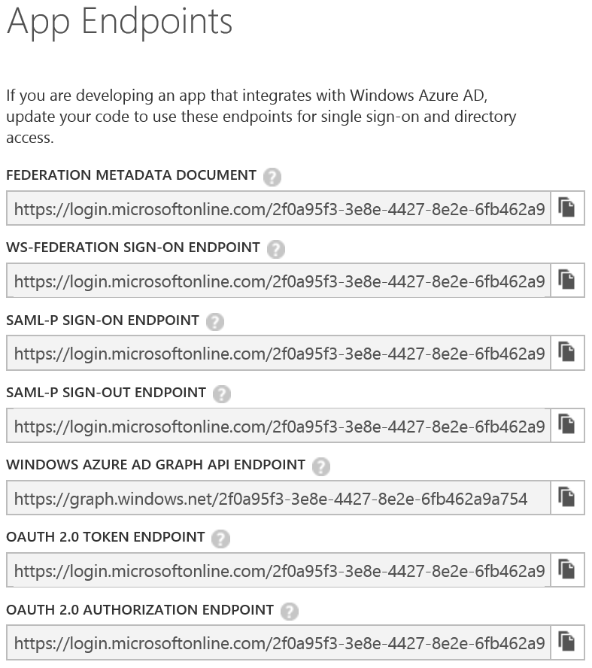
Azure AD Protocols & Tokens
WS-Federation Protocol & SAML token
SAML Protocol & SAML token
OpenID Connect 1.0 + OAuth 2 Protocol & JWT token
Notes:
Mention that Azure AD implements Open ID Connect 1.0, which extends the Oauth 2.0 protocol to enable user authentication. It returns an id_token in the response sent to the Authorize endpoint.
The screen capture is the App Endpoints dialog in the Azure portal showing the endpoints that every Azure AD tenant gets.
Reference
https://msdn.microsoft.com/en-us/library/azure/dn151124.aspx

Slide 32
Active Directory Authentication Library (ADAL)
A client library used to get an access token (JWT) from Azure AD
Provides automatic token caching to avoid unnecessary round trips to Azure AD
Available for multiple developer platforms
.NET/C#, Java, OSX & IOS, Android, JavaScript, Node.js
Is open sourced on GitHub
Notes:
The Azure AD authentication Library (ADAL) enables client application developers to easily authenticate users to cloud or on-premises Active Directory (AD), and then obtain access tokens for securing API calls.
ADAL has many features that make authentication easier for developers, such as asynchronous support, a configurable token cache that stores access tokens and refresh tokens, automatic token refresh when an access token expires and a refresh token is available, and more.
It is available on multiple platforms and is open sourced on Github

Slide 33
ADAL Classes
AuthenticationContext
Think of this as your connection to Azure AD
The AcquireToken method authenticates against Azure AD and returns an AuthenticationResult
AuthenticationResult
Contains and AccessToken property to access the requested resource
Includes an idToken containing identity claims about the user
Notes:
The following two classes are the key classes in ADAL
These include additional information such as token expiration, refresh token, tenant information
The idToken is Microsoft’s implementation of OpenID Connect where an identity token is returned from the authorization service.

Slide 34
Active Directory Authentication Library (ADAL) for .NET
Notes:
4A_ADAL_Graph.docx

Slide 35
Azure Active Directory Graph API
Programmable access to your Azure AD using REST API’s
Perform CRUD operations on directory objects
Query for directory object properties that are not included in the authentication token
Notes:
The Azure Active Directory (AD) Graph API provides programmatic access to Azure AD through OData REST API endpoints. Applications can use the Graph API to perform create, read, update, and delete (CRUD) operations on directory data and objects.
For example, you can use the Graph API to create a new user, view or update user’s properties, change user’s password, check group membership for role-based access, disable or delete the user.

Slide 36
Using Azure AD programmatically
Notes:
4B_ADAL_Graph.docx

Slide 37
Summary
Application Management and Access
Hybrid Identity
Developing applications for Azure Active Directory

